Slide 1
Soft Computing
By - Tanay Deshmukh
M.Sc. (Data Science & Analytics)
3rd Semester

Slide 2
Soft Computing
Principle components
Neural Network (NN)
Fuzzy Logic
Genetic Algorithm
Details -
A paradigm or model which can resolve issues which are not having proper predictions.
It involves unsure and imprecise solution.
It depends on formal logic and probabilistic reasoning.
It gives the amazing ability of the human mind. It can map a human mind.
Example -
A = “abc” & B = “abd”
Q. Are A & B same?
Ans. No
How much they are same?
Ans.

Slide 3
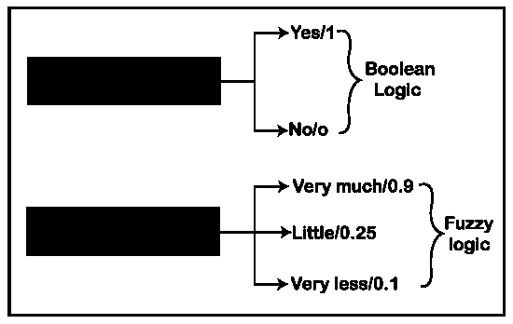
Fuzzy Logic
Applications
Businesses
Finance
Manufacturing industries
Details -
Mathematical logic.
Not clear.
Solve problems with an open and imprecise spectrum of data.
Best possible solution to complex problems
Is it hot water?
Is it hot water?

Slide 4
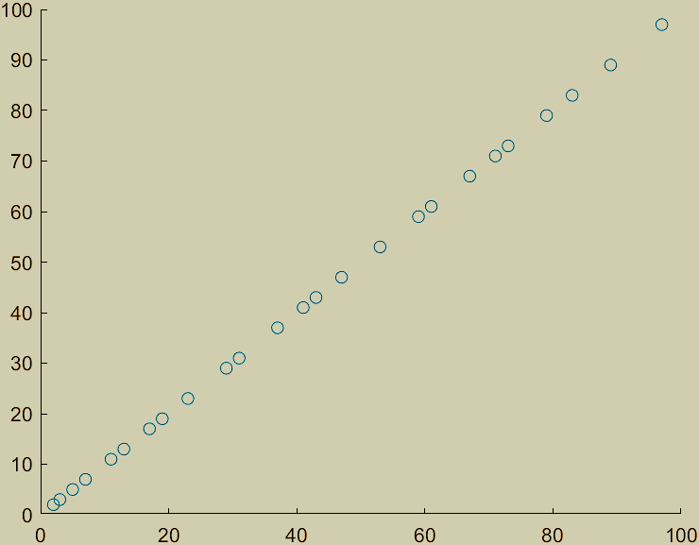
MatLab
Scatter Linear Graph
A = 1:100;
B = find(isprime(A))';
A = A(isprime(A));
scatter(B,A);
Details -
Let you see how different algorithms work with your data.
Makes data science easy with tools to access and preprocess data.
Build machine learning and predictive models, and deploy models to enterprise IT systems

Slide 5
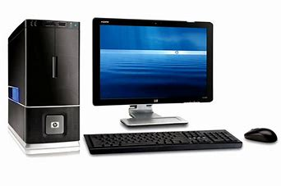
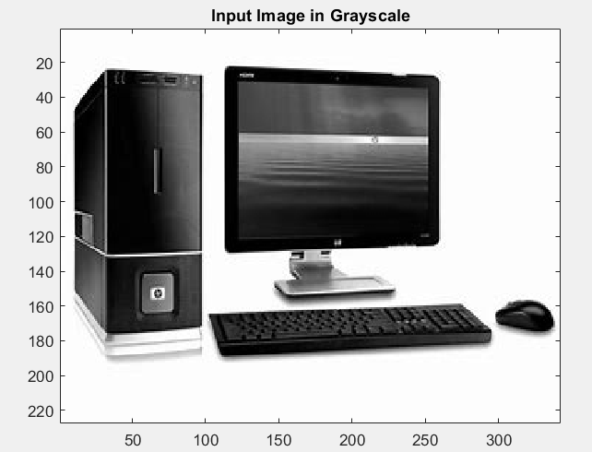
Fuzzy Logic Image Processing (detect edges in an image)
Import Image
rgb = imread(‘pc image test.jpg');
Convert Image to Grayscale
gray = rgb2gray(rgb);
figure
image(gray,'CDataMapping','scaled')
colormap('gray')
title('Input Image in Grayscale')
Convert Image to Double-Precision Data
I = im2double(gray);
Obtain Image Gradient
Gx = [-1 1]; Gy = Gx'; Ix = conv2(I,Gx,'same'); Iy = conv2(I,Gy,'same');

Slide 6
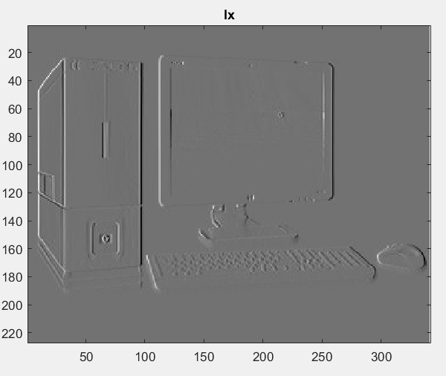
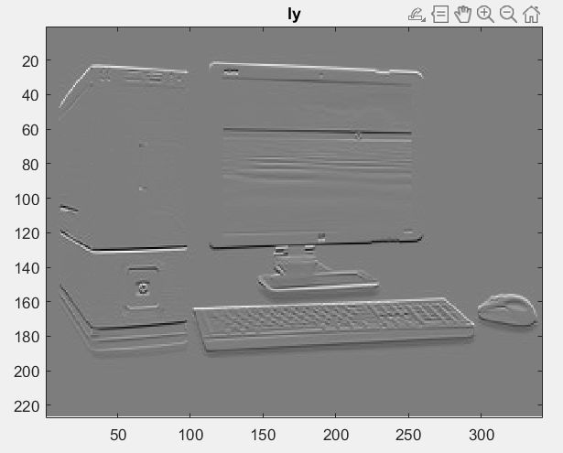
Plot the Image Gradients
figure image(Ix,'CDataMapping','scaled')
colormap('gray')
title('Ix')
figure
image(Iy,'CDataMapping','scaled')
colormap('gray')
title('Iy')
Define Fuzzy Inference System (FIS)
for Edge Detection
edgeFIS = mamfis('Name','edgeDetection');
edgeFIS = addInput(edgeFIS,[-1 1],'Name','Ix');
edgeFIS = addInput(edgeFIS,[-1 1],'Name','Iy');
sx = 0.1;
sy = 0.1;
edgeFIS = addMF(edgeFIS,'Ix','gaussmf',[sx 0],'Name','zero');
edgeFIS = addMF(edgeFIS,'Iy','gaussmf',[sy 0],'Name','zero');
edgeFIS = addOutput(edgeFIS,[0 1],'Name','Iout');

Slide 7
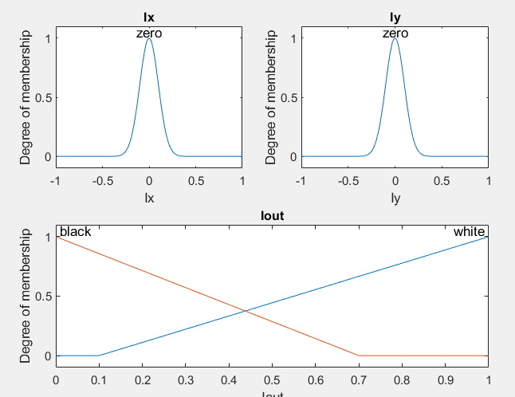
Specify the triangular membership functions, white and black, for Iout.
wa = 0.1;
wb = 1;
wc = 1;
ba = 0;
bb = 0;
bc = 0.7;
edgeFIS = addMF(edgeFIS,'Iout','trimf',[wa wb wc],'Name','white');
edgeFIS = addMF(edgeFIS,'Iout','trimf',[ba bb bc],'Name','black');
Plot the membership functions of the inputs and outputs of edgeFIS.
figure
subplot(2,2,1)
plotmf(edgeFIS,'input',1)
title('Ix')
subplot(2,2,2)
plotmf(edgeFIS,'input',2)
title('Iy')
subplot(2,2,[3 4])
plotmf(edgeFIS,'output',1)
title('Iout')

Slide 8
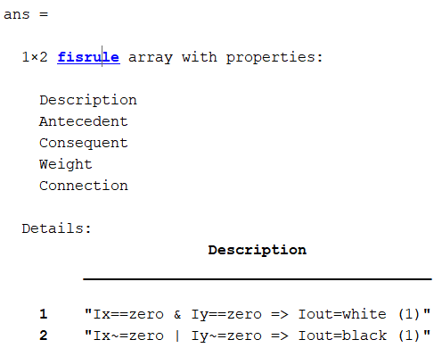
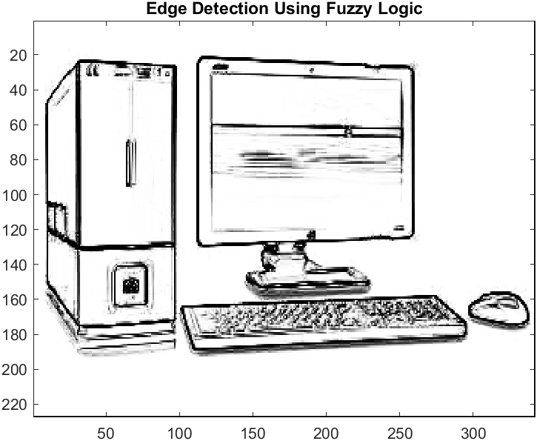
Specify FIS Rules
r1 = "If Ix is zero and
Iy is zero then Iout is white";
r2 = "If Ix is not zero or
Iy is not zero then Iout is black";
edgeFIS = addRule(edgeFIS,[r1 r2]);
edgeFIS.Rules
Evaluate FIS
Ieval = zeros(size(I));
for ii = 1:size(I,1)
Ieval(ii,:) = evalfis(edgeFIS,[(Ix(ii,:));(Iy(ii,:))]');
End
Plot Results
figure
image(Ieval,'CDataMapping','scaled')
colormap('gray')
title('Edge Detection Using Fuzzy Logic')
----------------------x----x---------------------------------

Slide 9
Refrences –
Fuzzy Logic Image Processing - MATLAB & Simulink - MathWorks India
Fuzzy Logic Tutorial – Javatpoint
Soft computing (ANN and Fuzzy Logic) : Dr. Purnima Pandit (slideshare.net)
Fuzzy Logic - Inference System (tutorialspoint.com)
https://github.com/Tanay44/MATLAB.git
Thank you Dr. Pankaj Dahsore

